Slide 1
Generalized Group Lasso for Predictive Biomarker Identification
Wenxuan Deng
Working with Kevin Galinsky and Jacob Zhang

Slide 2
Outline
Background:
What is a predictive biomarker?
Variable Selection with Lasso
Model:
Linear model
Group Lasso penalty term design
Simulations
Proportions of nonzero interactions
Signal to Noise ratio
Large-scale high dimensional data
Conclusions

Slide 3
Background

Slide 4
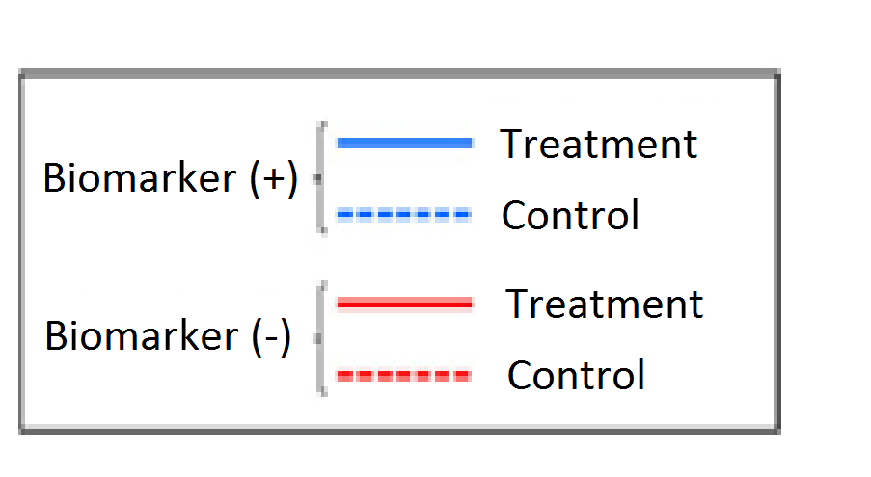
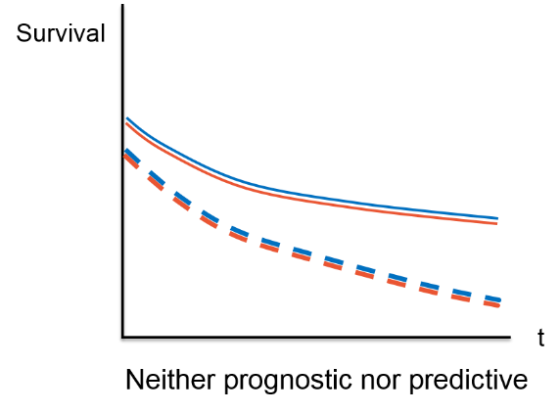
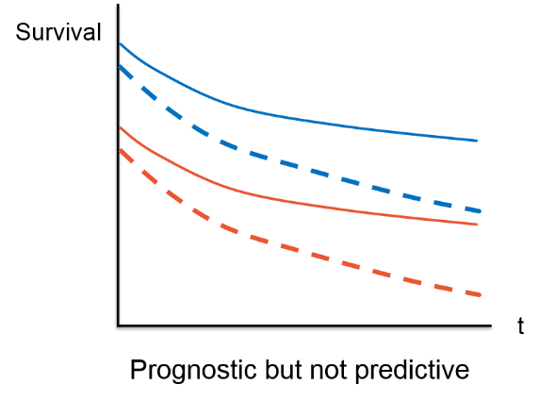
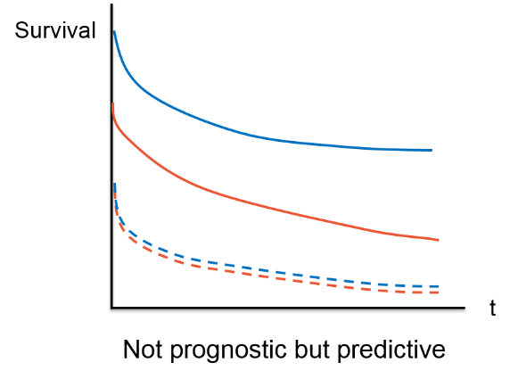
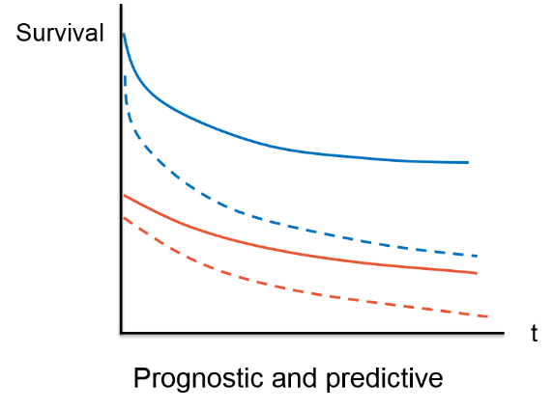
Predictive Biomarkers and Prognostic Biomarkers

Slide 5
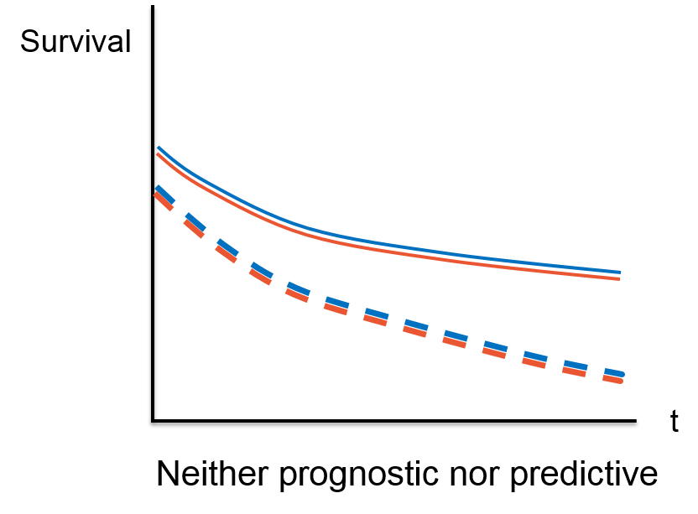
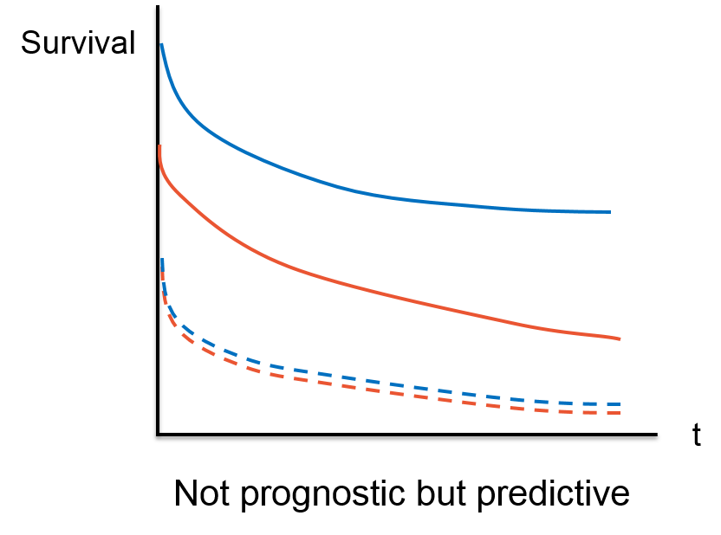

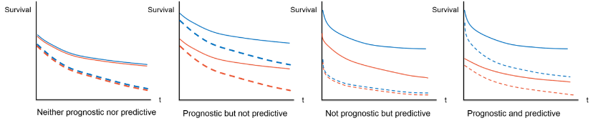
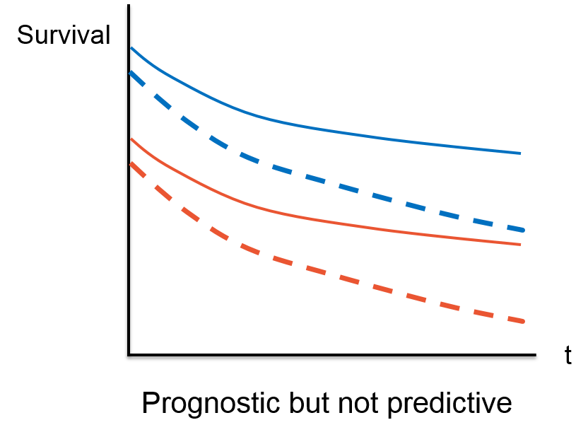
Predictive Biomarkers and Prognostic Biomarkers

Slide 6
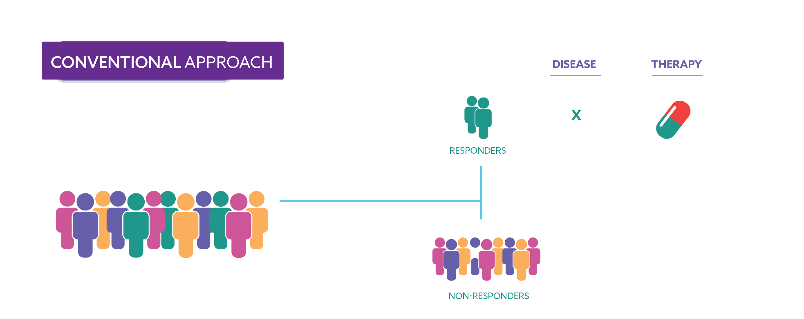
Patient Subgroup Identification

Slide 7
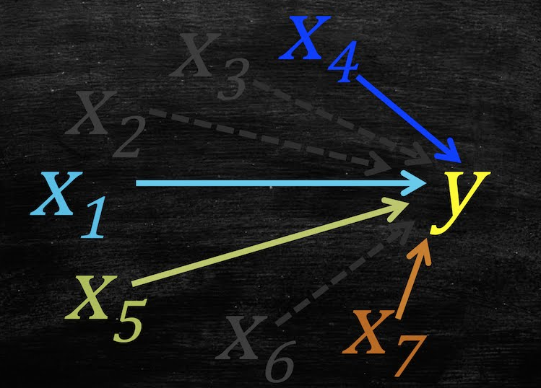
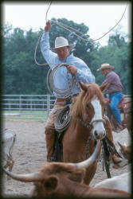
Variable Selection
Lasso
(Least Absolute Shrinkage and Selection Operation)

Slide 8
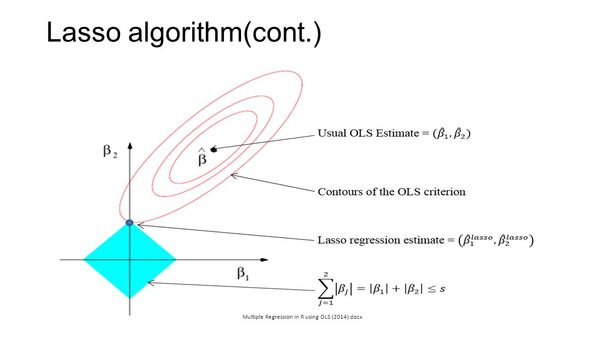
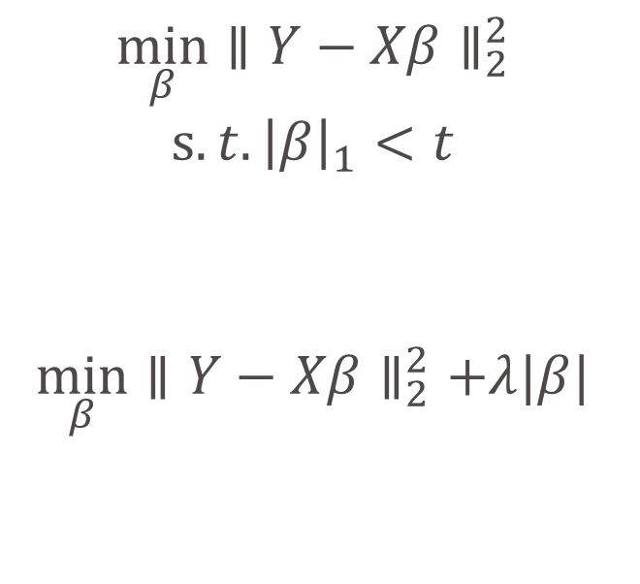
Lasso
$$\min_{β}∥Y−Xβ∥_{2}^{2}$$
$$s.t. {\left|β\right|}_{1}<t$$
$$\min_{β}∥Y−Xβ∥_{2}^{2}+λ|β|$$
Penalization

Slide 9
Model

Slide 10
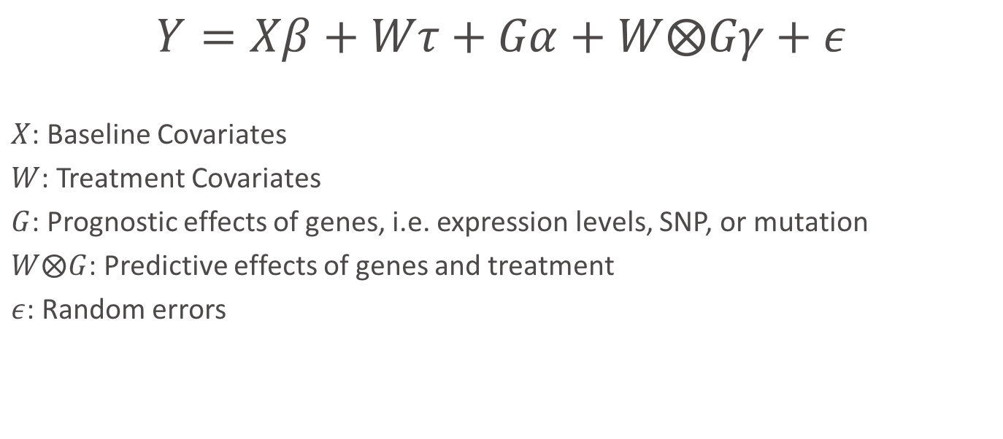
Model
$$Y=Xβ+Wτ+Gα+W⨂Gγ+ε$$
$X$: Baseline Covariates
$W$: Treatment Covariates
$G$: Prognostic effects of genes, i.e. expression levels, SNP, or mutation
$W⨂G$: Predictive effects of genes and treatment
$ε$: Random errors

Slide 11
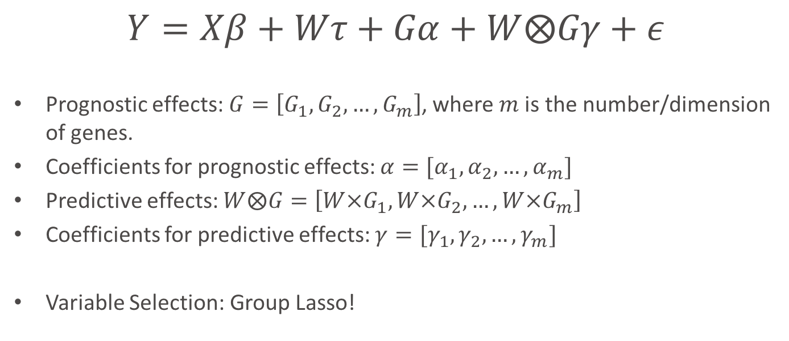
Model
$$Y=Xβ+Wτ+Gα+W⨂Gγ+ε$$
Prognostic effects: $G=\left[G_{1},G_{2},…, G_{m}\right]$, where $m$ is the number/dimension of genes.
Coefficients for prognostic effects: $α=[α_{1},α_{2},…, α_{m}]$
Predictive effects: $W⨂G=\left[W×G_{1},W×G_{2},…,W×G_{m}\right]$
Coefficients for predictive effects: $γ=[γ_{1},γ_{2},…, γ_{m}]$
Variable Selection: Group Lasso!

Slide 12
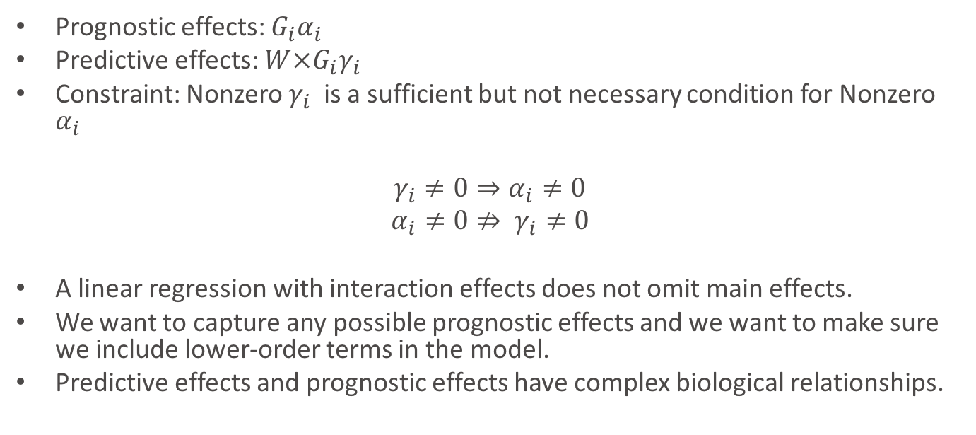
Hierarchical Structure Constraint
Prognostic effects: $G_{i}α_{i}$
Predictive effects: $W×G_{i}γ_{i}$
Constraint: Nonzero $γ_{i}$is a sufficient but not necessary condition for Nonzero $α_{i}$
$γ_{i}≠0⇒α_{i}≠0$
$$α_{i}≠0⇏ γ_{i}≠0$$
A linear regression with interaction effects does not omit main effects.
We want to capture any possible prognostic effects and we want to make sure we include lower-order terms in the model.
Predictive effects and prognostic effects have complex biological relationships.

Slide 13

Group Lasso
Why not Lasso?
We want the proposed Group Lasso method be capable to
Penalize on only part of predictors
Allow $p>n$
Have the hierarchical structure constraint

Slide 14
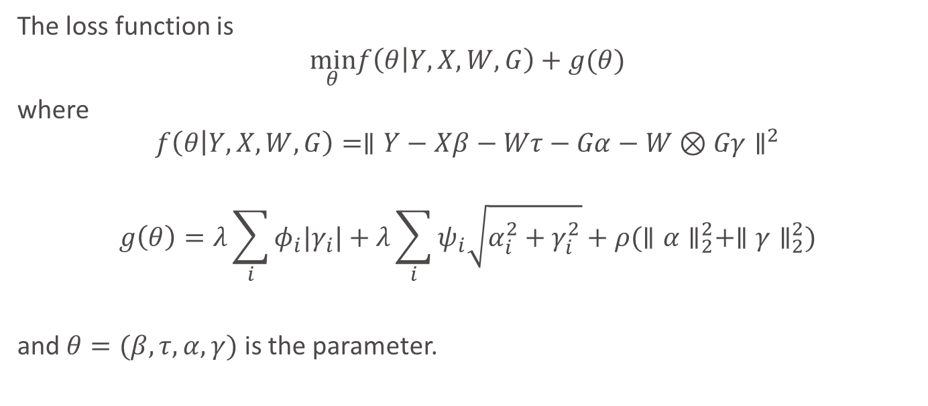
Loss Function
The loss function is
$$\min_{θ}f\left(θ | Y,X,W,G\right)+g(θ)$$
where
$$f\left(θ | Y,X,W,G\right)=∥Y−Xβ−Wτ−Gα−W⊗Gγ∥^{2}$$
$$g\left(θ\right)=λ\sum_{i}{φ_{i}|γ_{i}|}+λ\sum_{i}{ψ_{i}\sqrt{α_{i}^{2}+γ_{i}^{2}}+ρ(∥α∥_{2}^{2}+∥γ∥_{2}^{2})}$$
and $θ=(β,τ,α,γ)$ is the parameter.
Group Lasso Structure
Ridge Structure
Regularization
Parameter

Slide 15
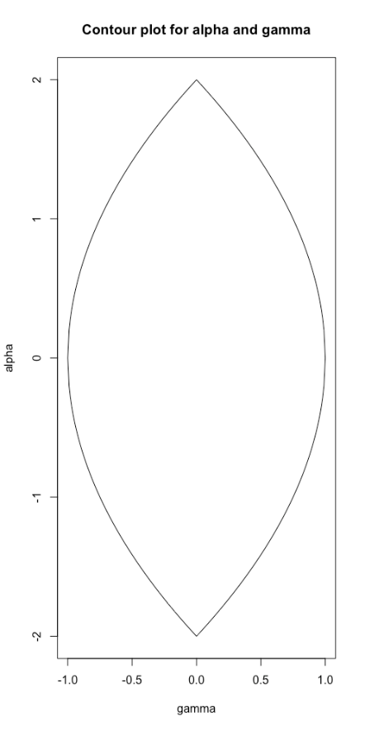



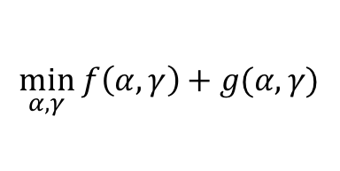



Geometrical Interpretation of Group Lasso Structure
$$γ=0, α≠0$$
Convex function $f(α,γ)$
$$\min_{α,γ} f\left(α,γ\right)+g(α,γ)$$
$$g\left(α,γ\right)=\left|γ\right|+\sqrt{α^{2}+γ^{2}}$$
$$γ≠0, α=0$$
$$γ≠0, α≠0$$

Slide 16
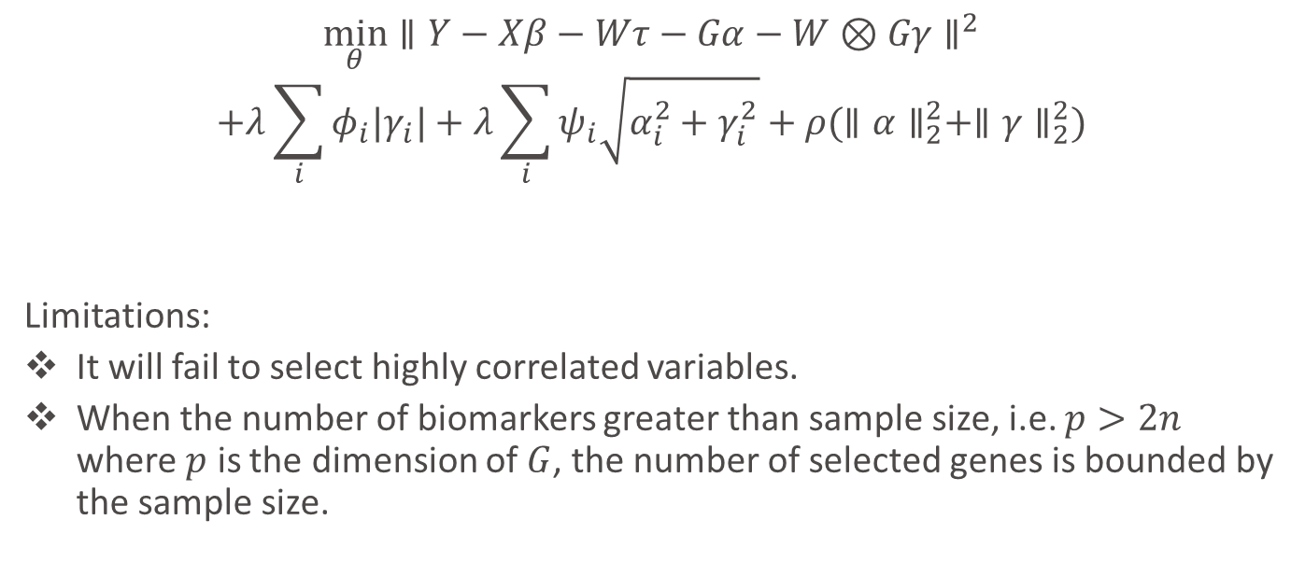
If Without Ridge Structure…
$$\min_{θ}∥Y−Xβ−Wτ−Gα−W⊗Gγ∥^{2}$$
$$+λ\sum_{i}{φ_{i}|γ_{i}|}+λ\sum_{i}{ψ_{i}\sqrt{α_{i}^{2}+γ_{i}^{2}}}+ρ(∥α∥_{2}^{2}+∥γ∥_{2}^{2})$$
Limitations:
It will fail to select highly correlated variables.
When the number of biomarkers greater than sample size, i.e. $p>2n$ where $p$ is the dimension of $G$, the number of selected genes is bounded by the sample size.

Slide 17
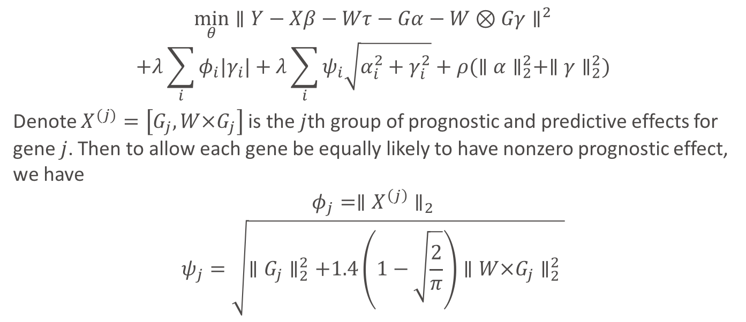
Adaptive Weights
$$\min_{θ}∥Y−Xβ−Wτ−Gα−W⊗Gγ∥^{2}$$
$$+λ\sum_{i}{φ_{i}|γ_{i}|}+λ\sum_{i}{ψ_{i}\sqrt{α_{i}^{2}+γ_{i}^{2}}}+ρ(∥α∥_{2}^{2}+∥γ∥_{2}^{2})$$
Denote $X^{(j)}=\left[G_{j},W×G_{j}\right]$ is the $j$th group of prognostic and predictive effects for gene $j$. Then to allow each gene be equally likely to have nonzero prognostic effect, we have
$$φ_{j}=∥X^{\left(j\right)}∥_{2}$$
$$ψ_{j}=\sqrt{∥G_{j}∥_{2}^{2}+1.4\left(1−\sqrt{\frac{2}{π}}\right)∥W×G_{j}∥_{2}^{2} }$$
Adaptive Weight

Slide 18
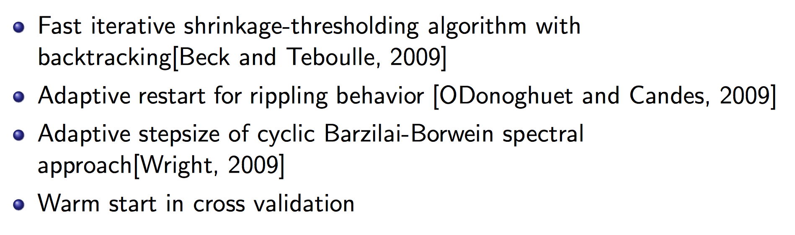
Optimization Strategies

Slide 19
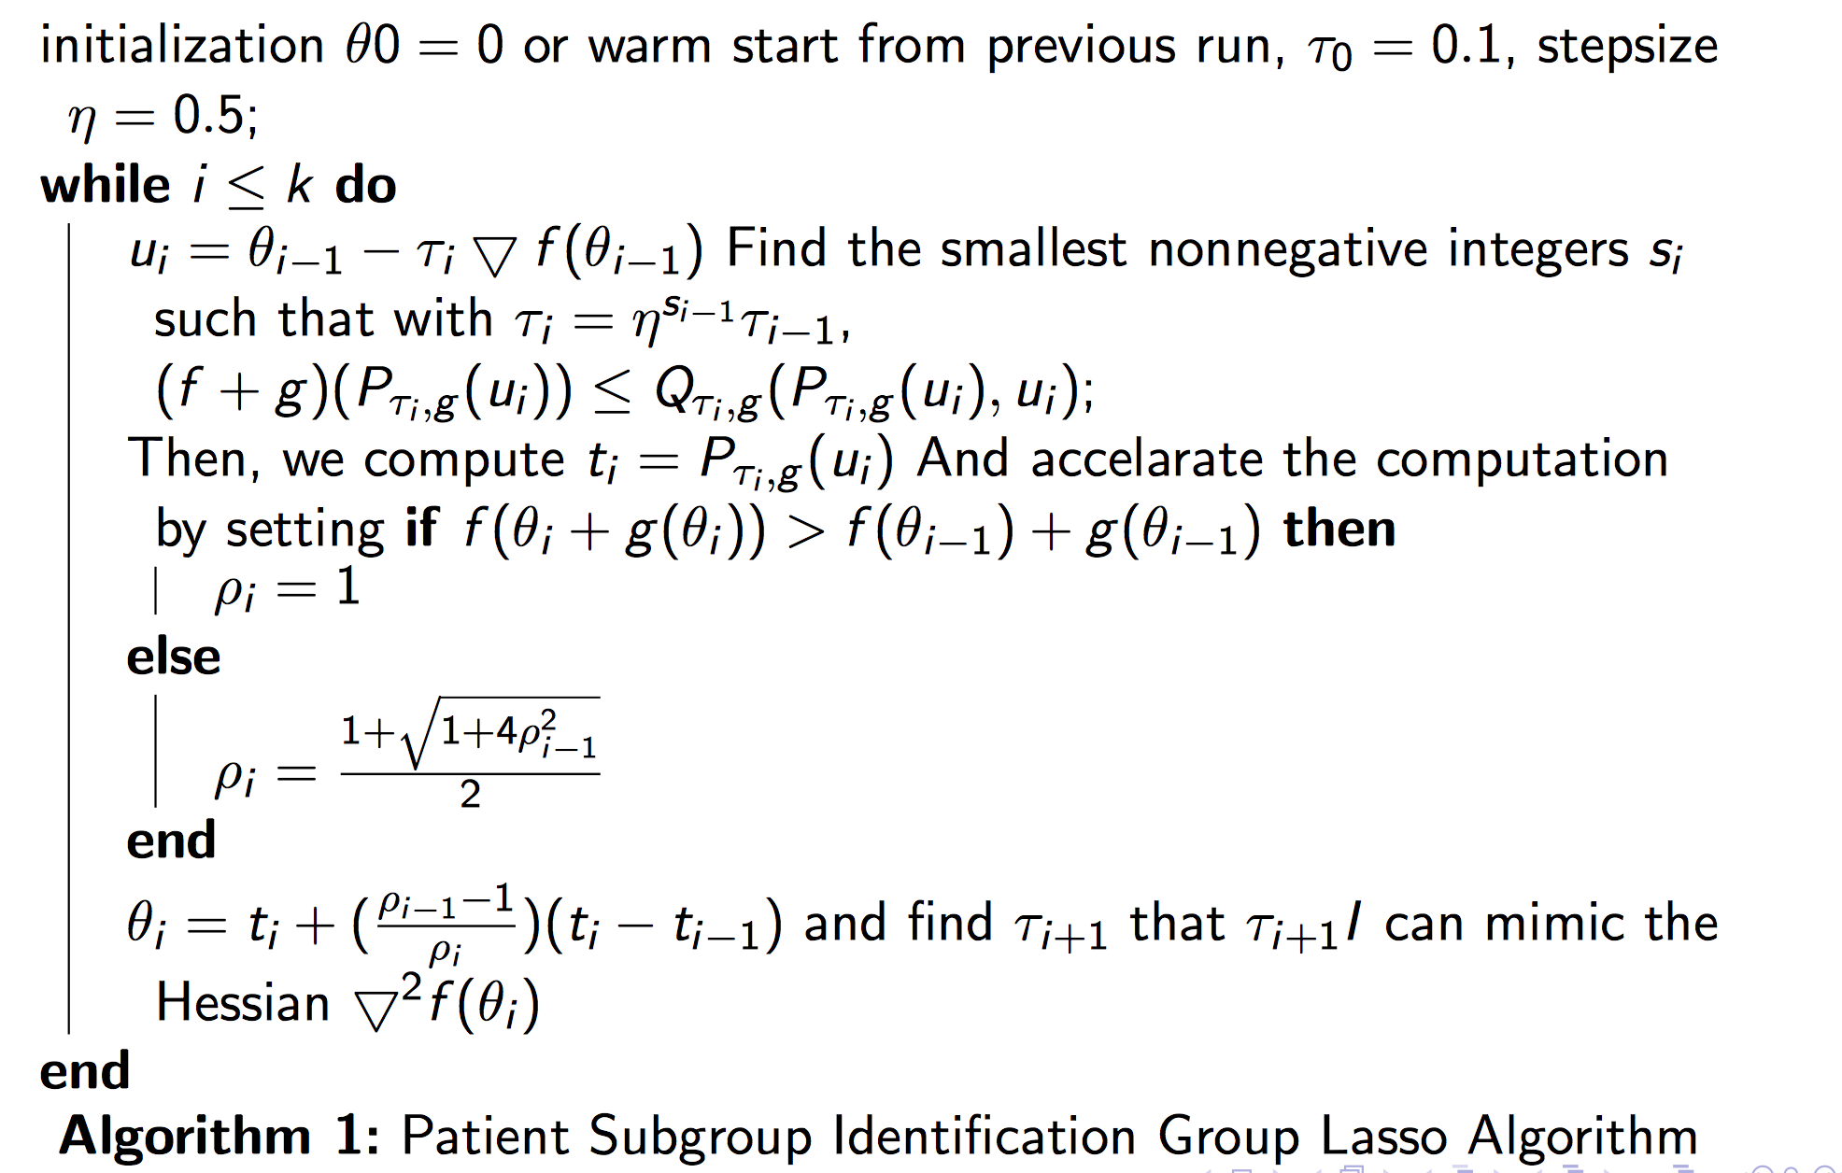
Algorithm

Slide 20
Simulations

Slide 21
Simulation Setup
Sample Size: N=100
Dimensions for baseline covariates = 5 (Standard Normal Distribution)
Dimensions for treatment covariate = 1, (binary: +1,-1)
Dimensions for Genes = 50, 100,200 (Standard Normal Distribution/Binomial Distribution)
Coefficients for baseline and treatment variables: standard normal distribution
Coefficients for genes=+3,-3,+5,-5
Iterations: 100

Slide 22



Simulation Setup
10%, 20%, 30%, 40% of genes have prognostic effects
5%, 10%, 15%, 20% of genes have predictive effects
Prognostic Effects
40%
$$α$$
Predictive Effects
20%
$$γ$$
$m$ genes

Slide 23
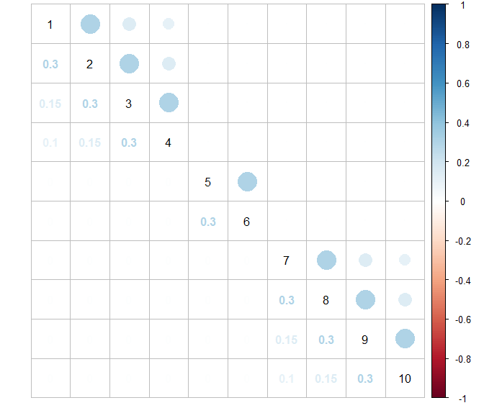
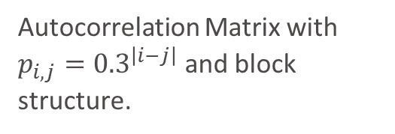
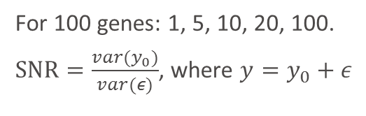
Correlation Structure
Simulation Setup
Autocorrelation Matrix with $p_{i,j}={0.3}^{\left|i−j\right|}$ and block structure.
Signal to Noise ratio (SNR)
For 100 genes: 1, 5, 10, 20, 100.
$SNR=\frac{var(y_{0})}{var(ε)}$, where $y=y_{0}+ε$

Slide 24
Simulation Setup
Proportion
Fixed number of genes: 100
Fixed SNR=10
Fixed covariates data type: Standard Normal Distribution
SNR
Fixed number of genes: 100
Fixed proportion of nonzero predictive biomarkers: 10%
Fixed covariates data type: Standard Normal Distribution
Dimension
Fixed proportion of nonzero predictive biomarkers: 10%
Fixed SNR=10
Fixed covariates data type: Standard Normal Distribution
SNP
Fixed number of genes: 100
Fixed proportion of nonzero predictive biomarkers: 10%
Fixed SNR=10

Slide 25
Simulation setup
 | Proportion | SNR | Dimension | SNP
# Predictive Biomarkers | 5%,10%, 15%,20% | 10% | 10% | 10%
# Biomarkers | 100 | 100 | 100,1000 | 100
SNR | 10 | 1,10,100 | 10 | 10
Covariate type | N(0,1) | N(0,1) | N(0,1) | N(0,1) Binom(2,0.5)

Slide 26
Other methods
General Elastic Net without penalizing baseline and treatment variables (Lasso)
Bayesian Model Averaging (BMA)
Stepwise Variable Selection by likelihood (step)
Iterative Sure Independent Screening (SIS)
Random Forest

Slide 27
Simulation Setup
Proportion of nonzero interaction effects
Fixed number of genes: 100
Fixed SNR=10
Fixed covariates data type: Standard Normal Distribution
SNR
Fixed number of genes: 100
Fixed proportion of nonzero predictive biomarkers: 10%
Fixed covariates data type: Standard Normal Distribution
Dimension
Fixed proportion of nonzero predictive biomarkers: 10%
Fixed SNR=10
Fixed covariates data type: Standard Normal Distribution
SNP
Fixed number of genes: 100
Fixed proportion of nonzero predictive biomarkers: 10%
Fixed SNR=10

Slide 28
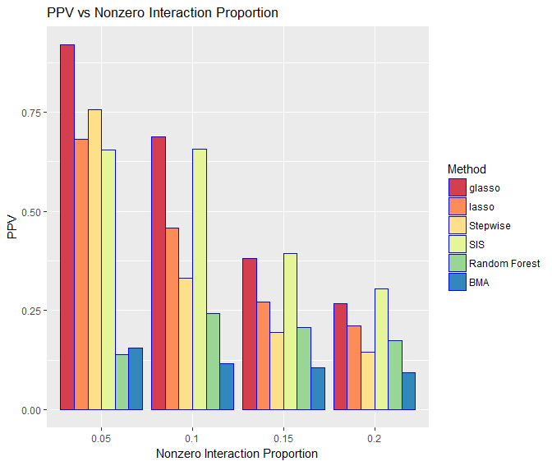
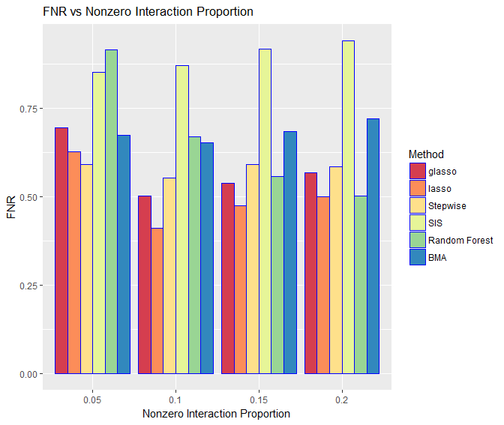
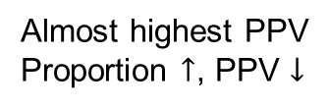
Results for different proportions of nonzero interaction effects
PPV=Positive Predictive Value
FNR=False Negative Rate
Almost highest PPV
Proportion $↑$, PPV $↓$
A relative low FNR

Slide 29
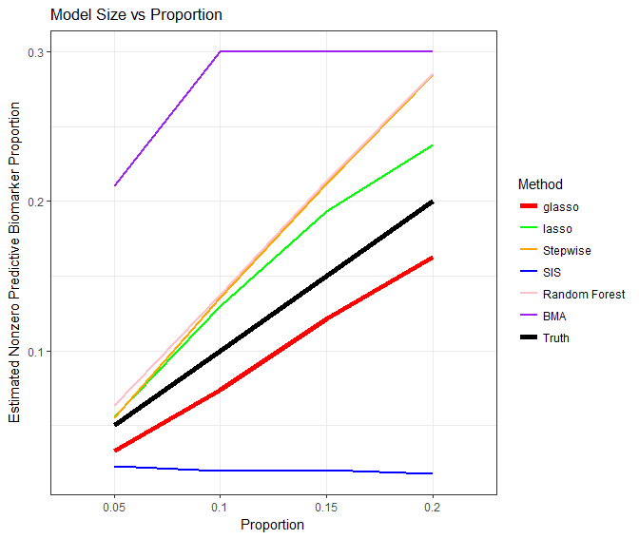
Results for different proportions of nonzero interaction effects
Group Lasso has the best performance.
Precision decreases as proportion of nonzero biomarkers increasing.
Group Lasso has an relative low FNR.
Group Lasso underestimated model size for predictive biomarkers.
Currently developing new stop criterion to reduce FNR.
Underestimated Model Size

Slide 30
Simulation Setup
Proportion
Fixed number of genes: 100
Fixed SNR=10
Fixed covariates data type: Standard Normal Distribution
Signal to Noise Ratio (SNR)
Fixed number of genes: 100
Fixed proportion of nonzero predictive biomarkers: 10%
Fixed covariates data type: Standard Normal Distribution
Dimension
Fixed proportion of nonzero predictive biomarkers: 10%
Fixed SNR=10
Fixed covariates data type: Standard Normal Distribution
SNP
Fixed number of genes: 100
Fixed proportion of nonzero predictive biomarkers: 10%
Fixed SNR=10

Slide 31
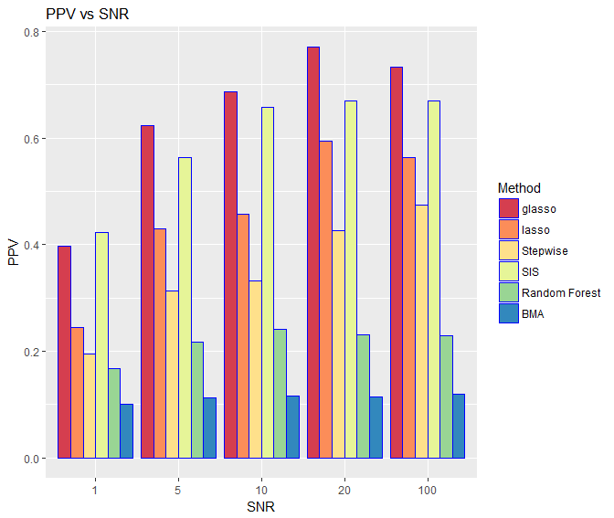
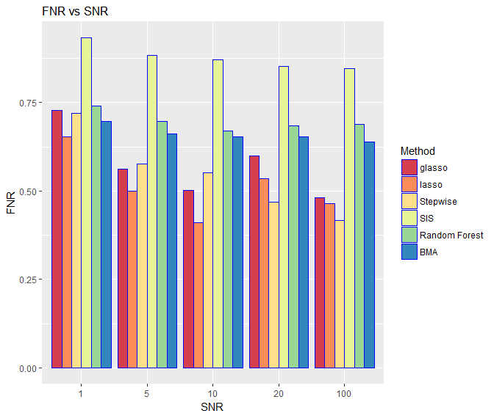
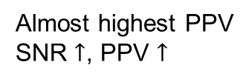
Results for different SNRs
Almost highest PPV
SNR $↑$, PPV $↑$
A relative low FNR

Slide 32
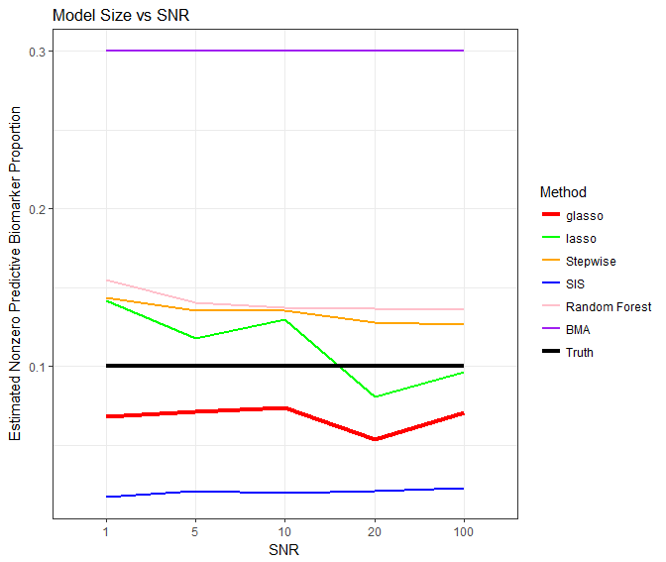
Results for different SNRs
Group Lasso has the best performance.
Precision increases as signal being stronger.
Group Lasso has an relative low FNR.
Group Lasso underestimated model size for predictive biomarkers.
Currently developing new stop criterion to reduce FNR.
Underestimated Model Size

Slide 33
Simulation Setup
Proportion
Fixed number of genes: 100
Fixed SNR=10
Fixed covariates data type: Standard Normal Distribution
Signal to Noise Ratio (SNR)
Fixed number of genes: 100
Fixed proportion of nonzero predictive biomarkers: 10%
Fixed covariates data type: Standard Normal Distribution
Dimension
Fixed proportion of nonzero predictive biomarkers: 10%
Fixed SNR=10
Fixed covariates data type: Standard Normal Distribution
SNP
Fixed number of genes: 100
Fixed proportion of nonzero predictive biomarkers: 10%
Fixed SNR=10

Slide 34
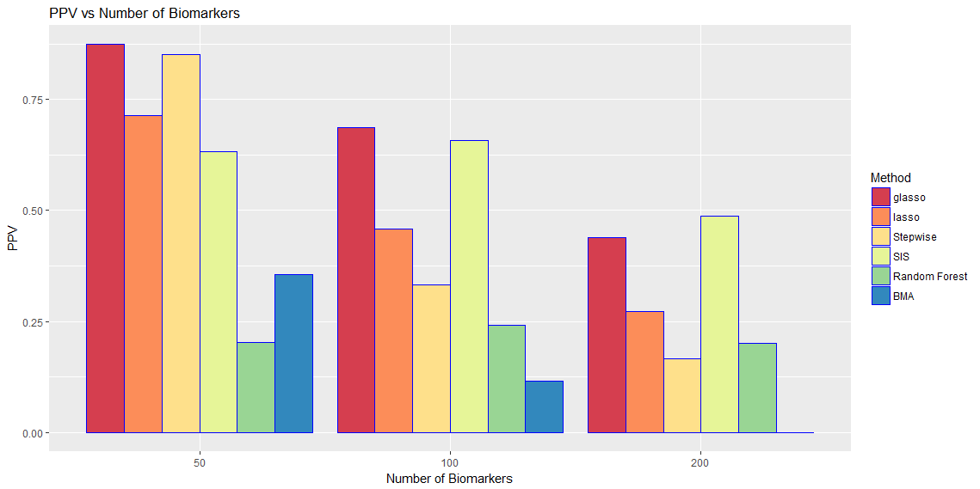
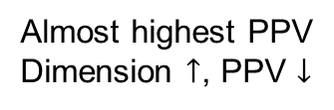
Results for different dimensions
Almost highest PPV
Dimension $↑$, PPV $↓$

Slide 35
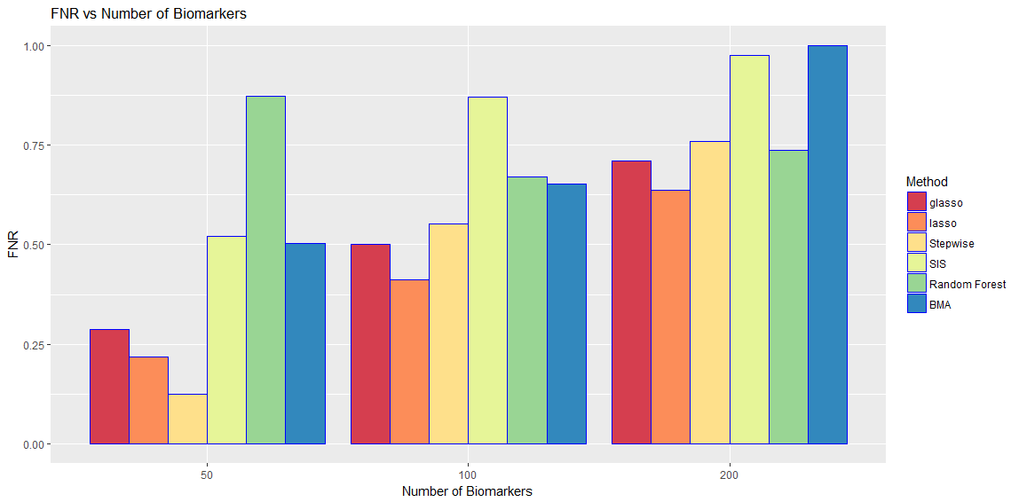
Results for different dimensions
A relative low FNR

Slide 36
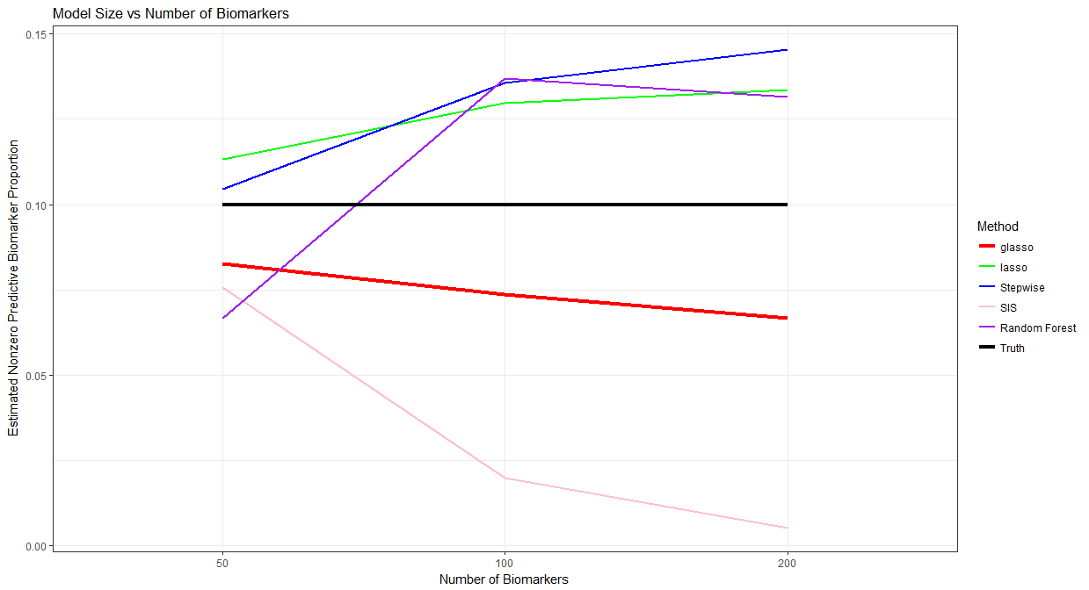
Results for different dimensions
Underestimated Model Size

Slide 37
Simulation Setup
Proportion
Fixed number of genes: 100
Fixed SNR=10
Fixed covariates data type: Standard Normal Distribution
Signal to Noise Ratio (SNR)
Fixed number of genes: 100
Fixed proportion of nonzero predictive biomarkers: 10%
Fixed covariates data type: Standard Normal Distribution
Dimension
Fixed proportion of nonzero predictive biomarkers: 10%
Fixed SNR=10
Fixed covariates data type: Standard Normal Distribution
SNP
Fixed number of genes: 100
Fixed proportion of nonzero predictive biomarkers: 10%
Fixed SNR=10

Slide 38
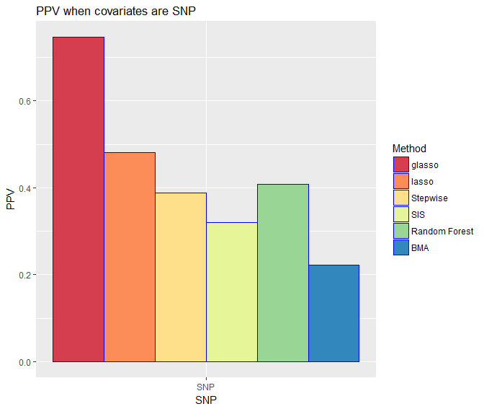
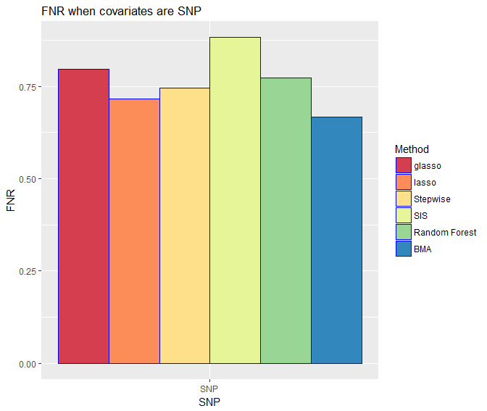
Results for SNP covariates
Almost highest PPV
A relative low FNR

Slide 39
Simulation Setup
Proportion
Fixed number of genes: 100
Fixed SNR=10
Fixed covariates data type: Standard Normal Distribution
SNR
Fixed number of genes: 100
Fixed proportion of nonzero predictive biomarkers: 10%
Fixed covariates data type: Standard Normal Distribution
Dimension
Fixed proportion of nonzero predictive biomarkers: 10%
Fixed SNR=10
Fixed covariates data type: Standard Normal Distribution
SNP
Fixed number of genes: 100
Fixed proportion of nonzero predictive biomarkers: 10%
Fixed SNR=10

Slide 40
Conclusions
Group Lasso has the best performance in all different scenarios.
Precision decreases as proportion of nonzero biomarkers increasing.
Precision increases as signal being stronger.
Group Lasso has an relative low FNR.
Group Lasso underestimated model size for predictive biomarkers.

Slide 41
Future Steps
Overlapping simulations without hierarchical structure
Stop criterion
Combination of Group Lasso with other methods
Generalization on other endpoints

Slide 42
Selected References
Yuan, Ming, and Yi Lin. "Model selection and estimation in regression with grouped variables." Journal of the Royal Statistical Society: Series B (Statistical Methodology) 68.1 (2006): 49-67.
Jacob, Laurent, Guillaume Obozinski, and Jean-Philippe Vert. "Group lasso with overlap and graph lasso." Proceedings of the 26th annual international conference on machine learning. ACM, 2009.
O’donoghue, Brendan, and Emmanuel Candes. "Adaptive restart for accelerated gradient schemes." Foundations of computational mathematics 15.3 (2015): 715-732.
Zhao, Peng, Guilherme Rocha, and Bin Yu. "The composite absolute penalties family for grouped and hierarchical variable selection." The Annals of Statistics 37.6A (2009): 3468-3497.
Miller, Alan J. "Selection of subsets of regression variables." Journal of the Royal Statistical Society. Series A (General)(1984): 389-425.
Beck, Amir, and Marc Teboulle. "A fast iterative shrinkage-thresholding algorithm for linear inverse problems." SIAM journal on imaging sciences 2.1 (2009): 183-202.
Zou, Hui, and Hao Helen Zhang. "On the adaptive elastic-net with a diverging number of parameters." Annals of statistics37.4 (2009): 1733.
Simon, Noah, et al. "A sparse-group lasso." Journal of Computational and Graphical Statistics 22.2 (2013): 231-245.
Liu, Jun, and Jieping Ye. "Fast overlapping group lasso." arXiv preprint arXiv:1009.0306 (2010).
Zou, Hui, and Trevor Hastie. "Regularization and variable selection via the elastic net." Journal of the Royal Statistical Society: Series B (Statistical Methodology) 67.2 (2005): 301-320.
Lim, Michael, and Trevor Hastie. "Learning interactions via hierarchical group-lasso regularization." Journal of Computational and Graphical Statistics 24.3 (2015): 627-654.

Slide 43
Thanks!

